Slide 1

Lesson objective
Title: The $n^{th}$ term
Aim – be able to:
Determine a sequence rule from a table of values
Use rule to generate a term in the sequence
Plan:
Spatial patterns
Algebra revision
Creating rules
Need whiteboards and calculators.

Slide 2
Sequences
Key words:
Sequence –
Term –
Common Difference –
A list of numbers or shapes that follow some pattern
A number or shape in the sequence
The constant rate at which a sequence increases or decreases

Slide 3

Whiteboards
Draw the next term in the sequence
Write the number pattern (how many matches)
Describe a rule in words

Slide 4
Daily review (I do)
To evaluate an expression, we substitute (replace) the pronumeral with a given value.
E.g. If d = 7, evaluate
4d
2d + 9
20 – 3d

Slide 5

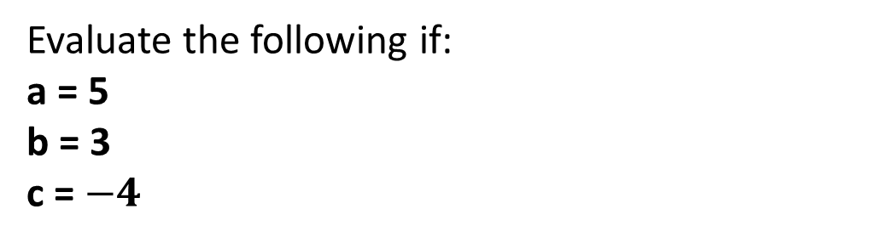
Your turn
Evaluate the following if:
a = 5
b = 3
c = $−4$
25
12
6
3a + 4b
10b – c
2a + c
$20 −(−10)$
$100+(−97)$
$10 −\left(−2.5\right)$
5a
9 + b
10 + c
27
34
6
30
3
12.5

Slide 6
Your turn
Evaluate the following if:
a = 5
b = 3
c = $−4$
5a
9 + b
10 + c
3a + 4b
10b – c
2a + c
$20 −(−10)$
$100+(−97)$
$10 −\left(−2.5\right)$

Slide 7

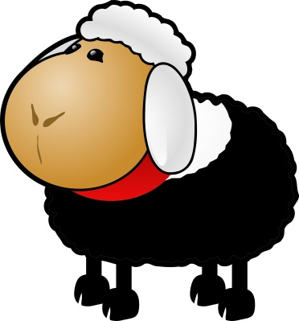
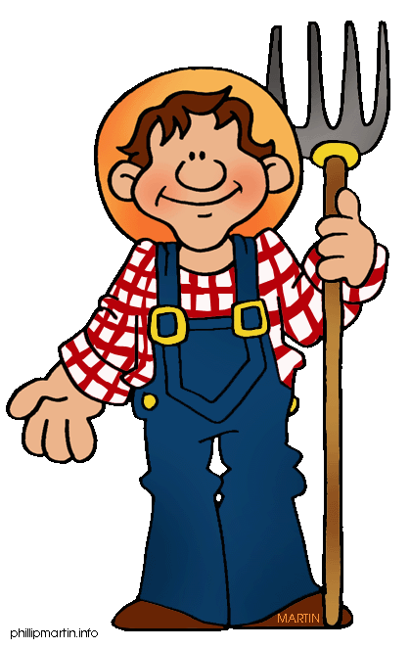



Farmer Barleymow

Slide 8
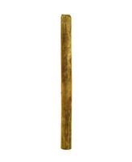
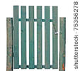
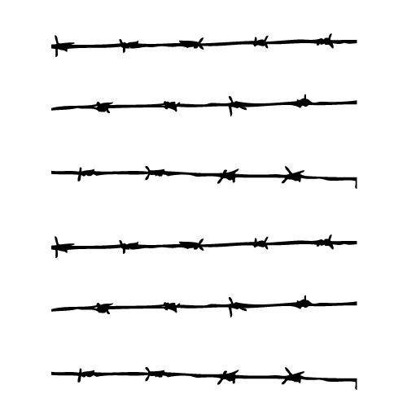
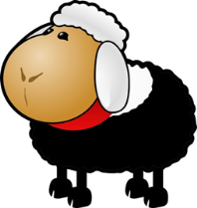




14m

Slide 9
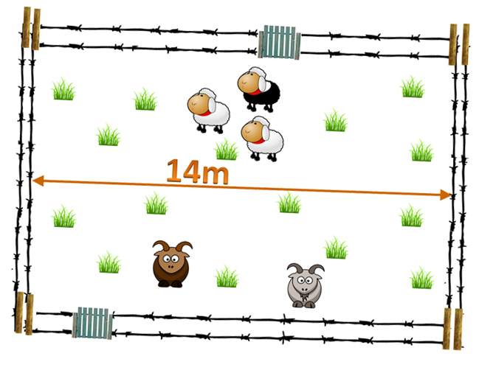
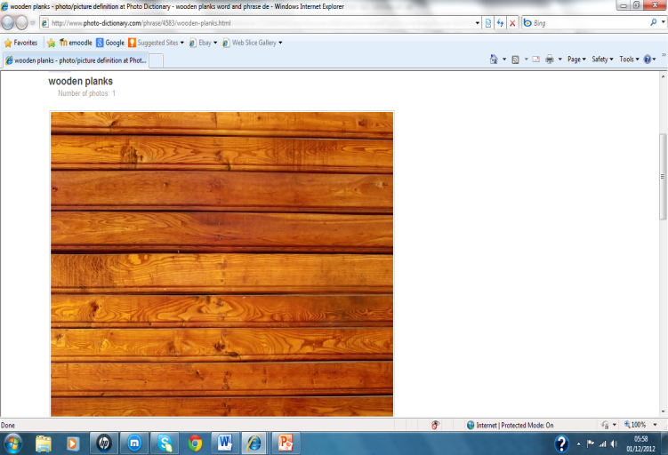


1m
Task:
Draw the pattern for a 3m section of fence and count how many pieces of wood are used
1m section of fence
2m section of fence

Slide 10
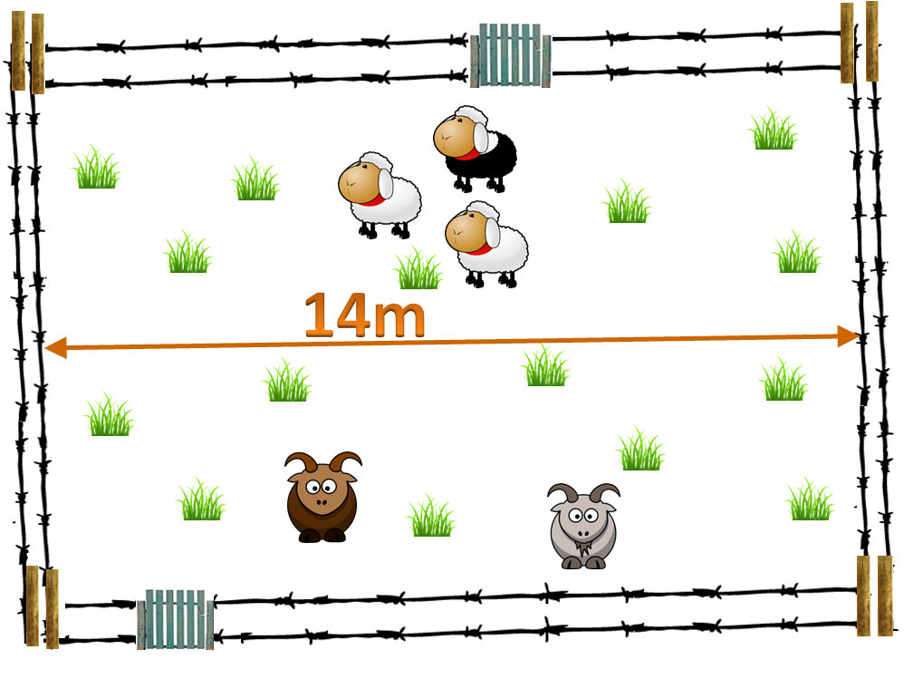
3m section of fence
10m of wood
How much wood for
14m of fencing?

Slide 11
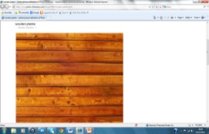




Pattern
n
Pattern
number
1
2
3
4
4
+3
7
+3
10
+3
13
Wood
3n
+1
3
6
9
12
+ 3
What else goes up
in 3s ??
term-to-term rule:
3n
+ 1
nth term rule:
How much wood for
14m of fencing?
3 times tables!

Slide 12
Pattern
Pattern
number
Wood
nth term rule:
term-to-term rule:

Slide 13

Pattern
n
1
2
3
4
4
7
10
13
Wood
3n
+ 1
nth term rule:
n=14
Task:
Use the nth term rule to calculate how many pieces of wood are needed for a 14m section of fence
3n+1 =
(3x14)+1=
=43

Slide 14
Pattern
n
1
2
3
4
4
7
10
13
Wood
3n
+ 1
nth term rule:
n=14
Task:
Use the nth term rule to calculate how many pieces of wood are needed for a 14m section of fence

Slide 15




I need a taller
fence!!

Slide 16
1m
2m
Task:
Draw the pattern for a 3m section of fence and count how many pieces of wood are used

Slide 17



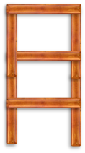
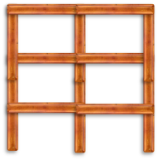
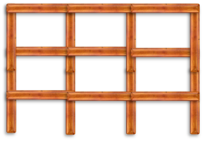
Task:
Calculate the nth term rule for this sequence and use to work out how much wood is needed for a 14m section of fencing
Rule is 5n+2
3m section
For 14m fence,
17 pieces of wood
(5x14)+2=
=72
Pattern
n
1
2
3
-5
7
+5
12
+5
17
Wood
nth term rule
5n
+2

Slide 18
Matchstick Patterns
Number of huts (n) | 1 | 2 | 3 | 4
Matches
- 5
6
11
16
21
1
+5
+5
+5
Rule is: 5n
+ 1

Slide 19
Matchstick Patterns
Number of huts (n) | 1 | 2 | 3 | 4
Matches
Rule is:

Slide 20
Number of matches =
5n + 1
How many matches need for 50 huts?
Matches = (5 x 50) + 1
= 251

Slide 21
Number of matches =
5n + 1
How many matches need for 50 huts?
Matches = ______________

Slide 22
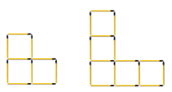



Find the n^{th} term rule and use it to work out how many matches
are needed for the 50th pattern in these sequences:
6n-2
1.
n^{th} term rule
Matches in
50th pattern
298
Number of
matches
4
10
16
n^{th} term rule
3n+1
2.
Number of
matches
4
7
10
Matches in
50th pattern
151
2n+1
3.
n^{th} term rule
Number of
matches
3
5
7
Matches in
50th pattern
101

Slide 23
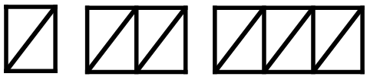
n^{th} term rule
4.
3n
Number of
matches
3
6
9
12
Matches in
50th pattern
150
n^{th} term rule
5.
8n-4
Number of
matches
4
12
Matches in
50th pattern
396
20
6.
n^{th} term rule
7n+1
Number of
matches
8
15
22
Matches in
50th pattern
351
7.
n^{th} term rule
Number of
connecting
rods in
each shape
4n+1
5
9
13
rods in
25th pattern
101

Slide 24
Find the n^{th} term rule and use it to work out how many matches
are needed for the 50th pattern in these sequences:
1.
n^{th} term rule
Name:
Matches in
50th pattern
Number of
matches
n^{th} term rule
2.
Number of
matches
Matches in
50th pattern
3.
n^{th} term rule
Number of
matches
Matches in
50th pattern

Slide 25
n^{th} term rule
4.
Number of
matches
Matches in
50th pattern
n^{th} term rule
5.
Number of
matches
Matches in
50th pattern
6.
n^{th} term rule
Number of
matches
Matches in
50th pattern
7.
n^{th} term rule
Number of
connecting
rods in
each shape
lines in
25th pattern

